Slide 1

COVID 19 DATASET
By-
Nikhil 121910312016
Sandeep 121910312023
Pasyanthi 121910312035
Vivek 121910312046

Slide 2
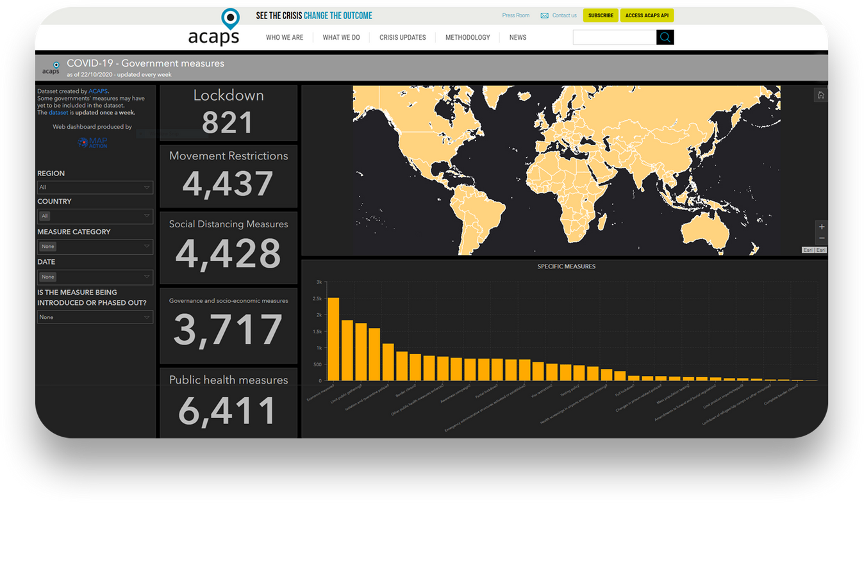
Agenda
Introduction
Abstract
Problem scope Objectives
overview of technologies
Final conclusion

Slide 3
Introduction
The COVID-19 India Dataset is one of the most comprehensive datasets on the pandemic in India. It aggregates data from health bulletins published online daily by governments of major Indian states. The main idea of this research is to come up with models for analysis, prediction, and insights on the evolution of the pandemic in India.

Slide 4
PROBLEM IDENTIFICATION
The whole world was affected with a pandemic Covid-19. It impacted the ways of the world very deeply. India also subdued a lot damage and changes. The whole period of 2020-2022 was very chaotic. There was an outrageous surge in the amount of positive covid cases and deaths, sadly.
The main idea of this research is to study, analyze and predict the trends of covid, positive cases, and deaths in Telangana and Tamil Nadu.

Slide 5
OBJECTIVES
Following are the objectives of this research:
1. To Identify Cause and Effect of different covid-waves.
2. To identify the merits of vaccine and lockdown to reduce hospitalization and fatality rate.

Slide 6
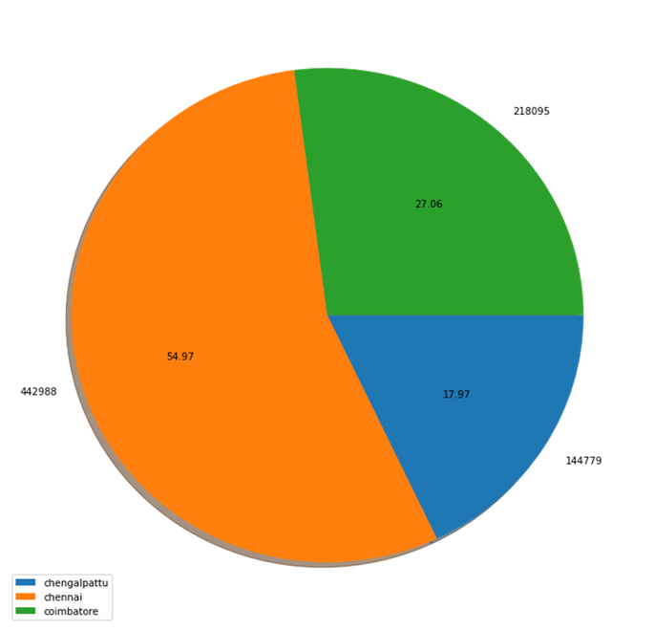
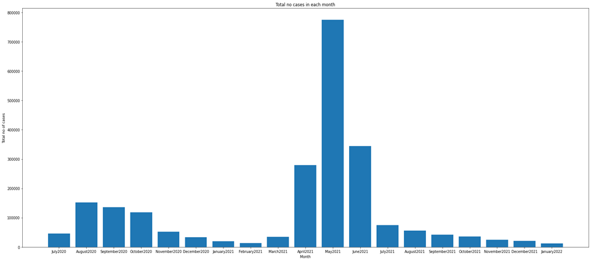
Final conclusion
The graph plots total no of positives cases per month in Tamil Nadu.
The pie chart shows major cities contribution to total cases in Tamil Nadu.

Slide 7
Final conclusion
1. Festivals, mass gathering in election rallies, not following strict lockdown in states were some of the major reasons for high positive case, hospitalisation and fatality.
2. Poor medical infrastructure and poor rate of vaccination, in the country has caused a lot of discomfort to people and to the medical fraternity in this pandemic.
3. Vaccination played a major role to reduce hospitalisation and fatality.
4. It was identified that all perfect models truly displayed the actual factors behind “total cases” and “total death”. At the same time practical model gave us an idea on how to develop machine learning model which are feasible in real world.
5. We also identified that cities and district with big population were major contributors in positive cases and fatalities in their respective states.
6. With available data in some states, it was found that fatalities with comorbidities were more than fatalities without comorbidities.
7. With available data in some states, fatality was more in the age group 45 and above.

Slide 8



Thank You

